Slide 1



Session will be presented
VIRTUALLY
Advanced List Formatting
Chris Kent
@theChrisKent

Slide 3





Chris Kent
O365 Practice Lead, DMI
@thechriskent
thechriskent.com

Slide 4


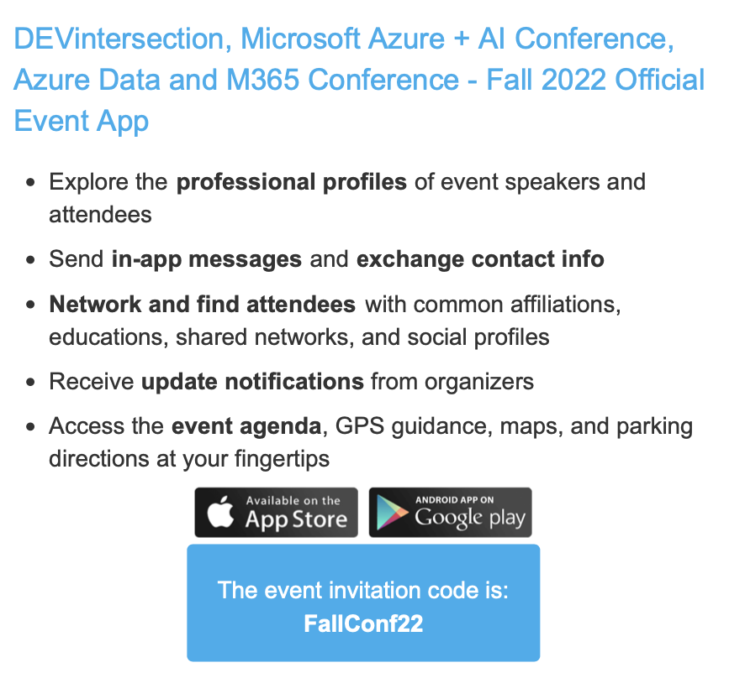

Slide 5
Goals

Slide 6
List Formatting
Columns | Views | Forms

Slide 7
Code Portion of “Low Code”
JSON | Operators | Advanced

Slide 8
Resources
Samples | Guidance | Tools
Notes:
Slides are intended for reuse. Lots of information on them, we’ll be moving quickly. Goal is to make you aware of what you can do and provide guides for when you do it later.

Slide 10

List Formatting
Declarative modern listview customization
Column Formatting
View Formatting
List Form Formatting

Slide 11
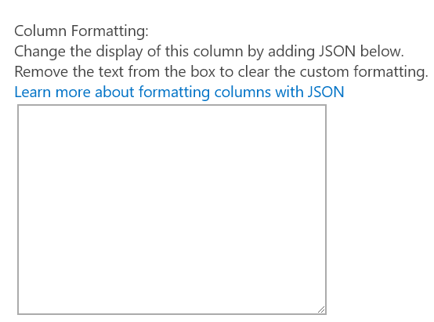
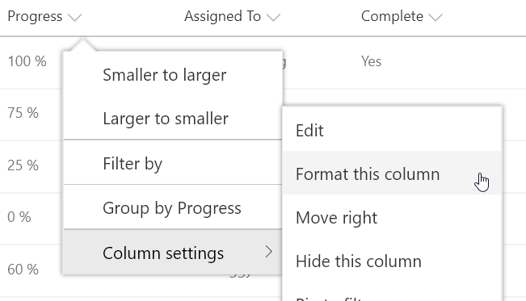
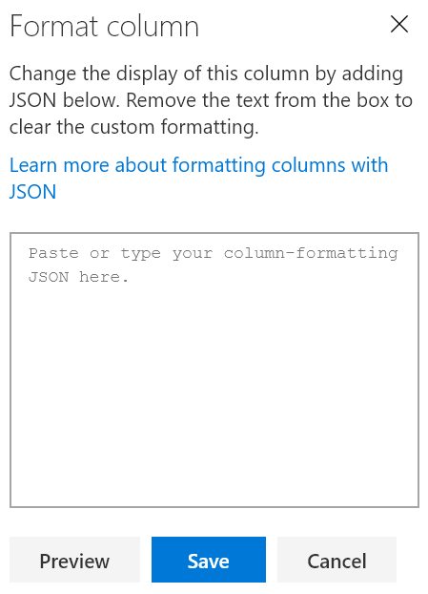

Column Formatting
JavaScript Object Notation (JSON)
Apply directly to list fields or site columns
Field Settings
Format this column menu
Stored with the Field
Paste Here
O365 & 2019

Slide 12
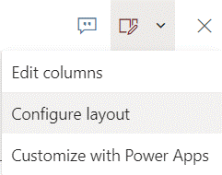
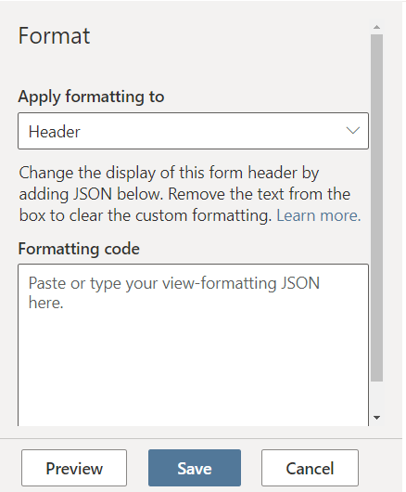

Form Formatting
Online Only
Header & Footer
Superset of Column Formatting
Body
JSON, but NOT Formatting
Stored with the List
Paste Here

Slide 13
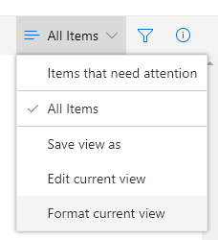
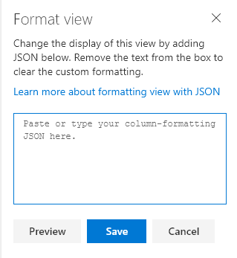

View Formatting
Online Only
Superset of Column Formatting
Apply directly to views
Format current view menu
Stored with the View
Overrides Column Formats (Row Formats)
Paste Here

Slide 14
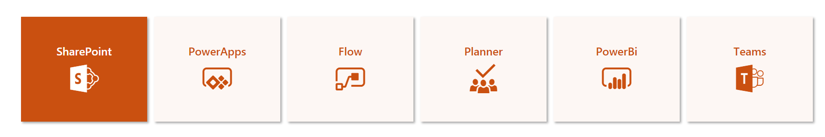
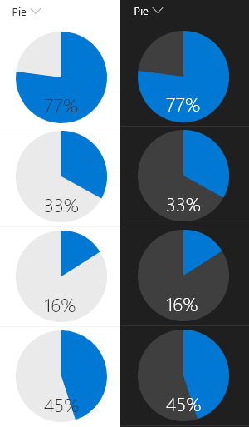
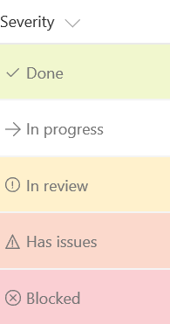
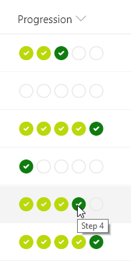
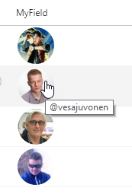
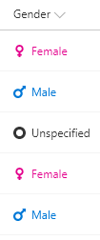
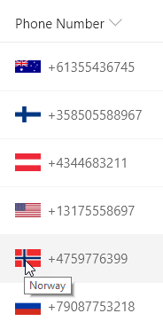
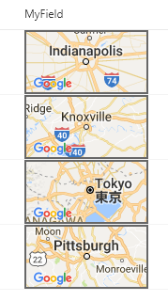
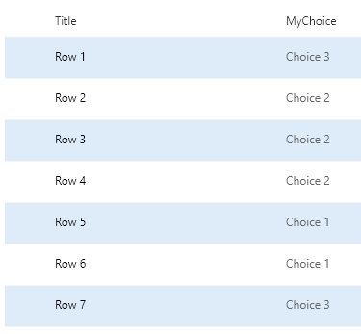
List Formatting Samples
200+ Sample Formats
Instructions & Screenshots
Copy & Paste directly from GitHub
Aka.ms/List-Formatting

Slide 15
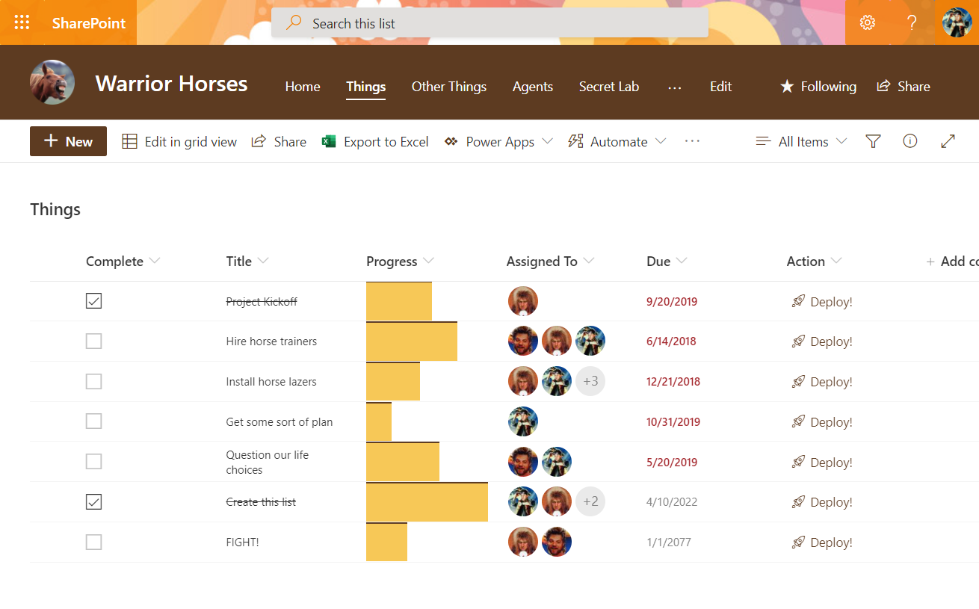

Slide 16
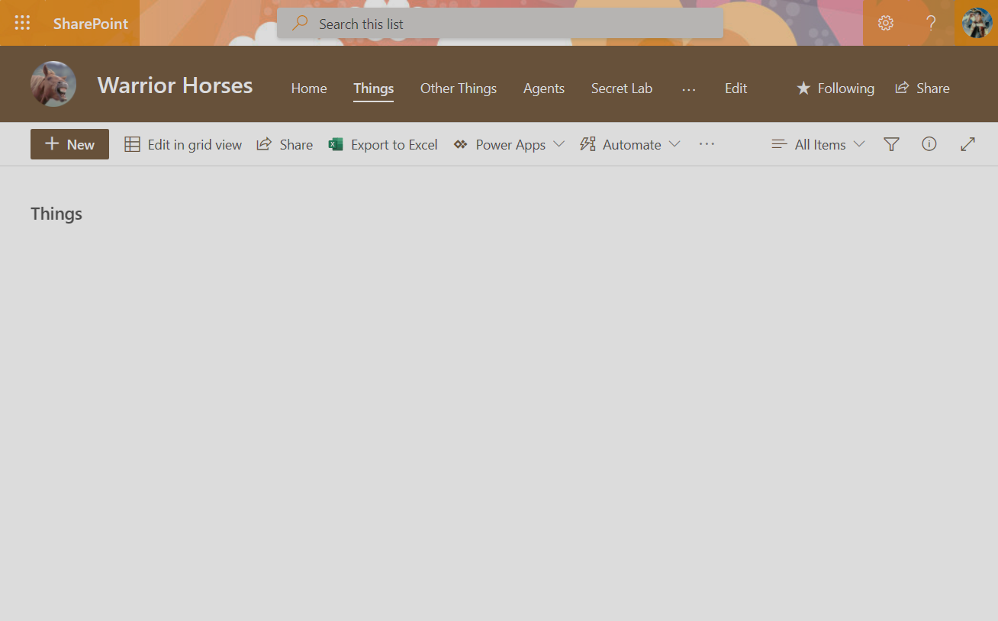
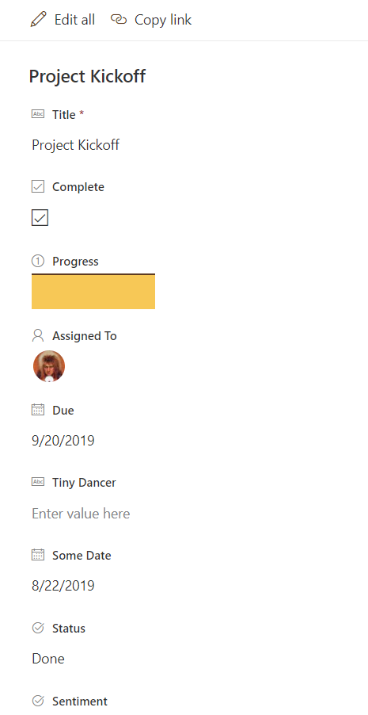
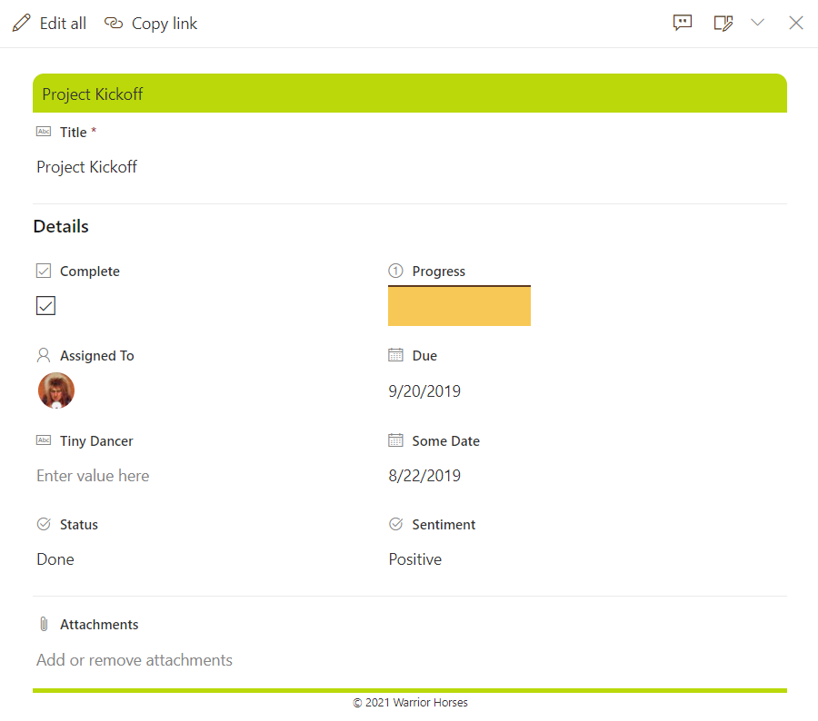
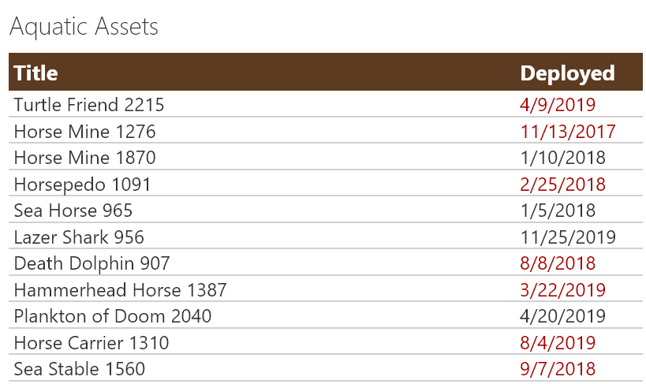
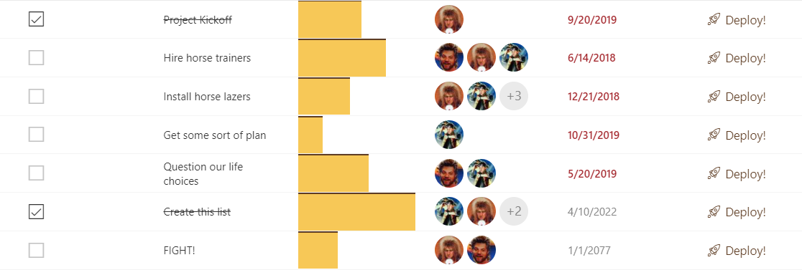
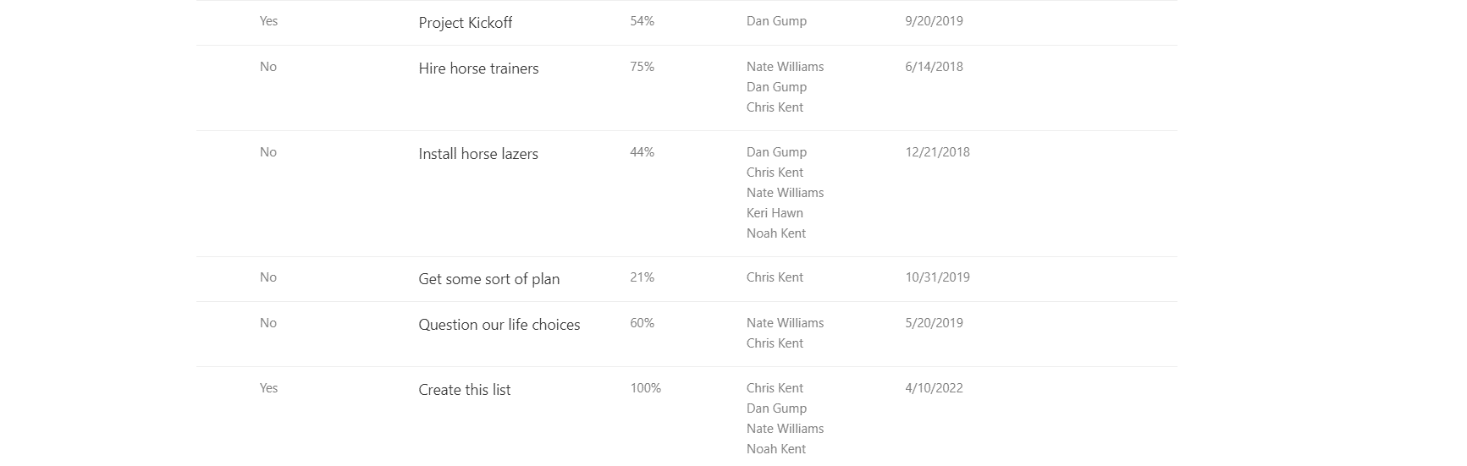
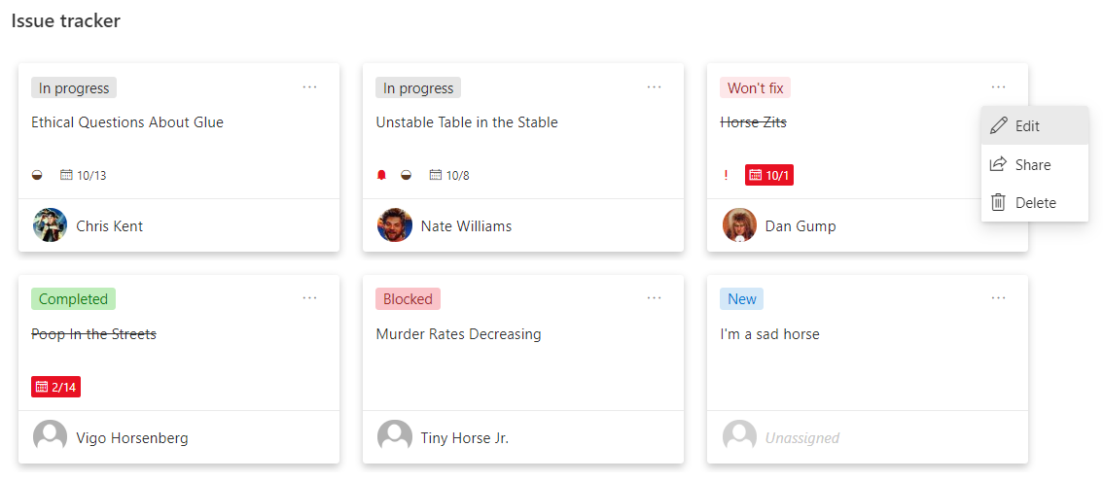
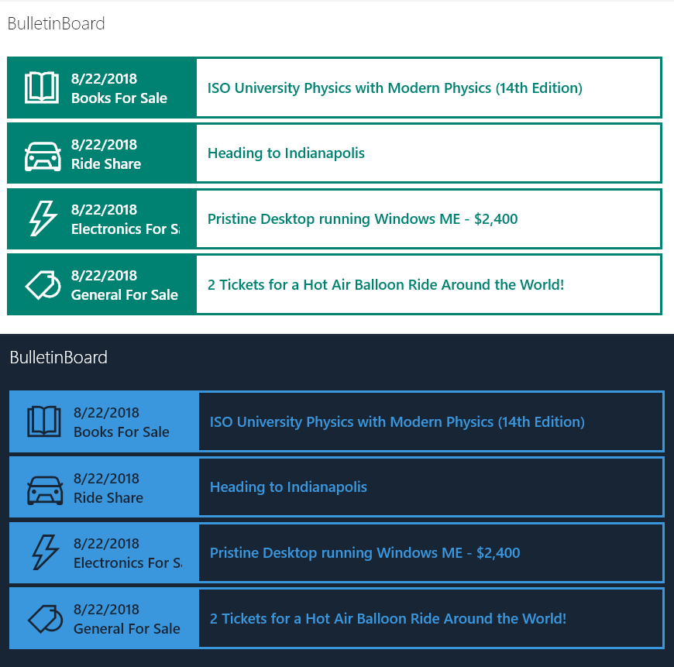

commandBarProps
(commands)
Row Formatter
(View formats, overridden headers, etc.)
Form Header
Standard UI
(Headers, Unformatted Groups, Aggregates, etc.)
tileProps
(Gallery)
Body Layout
(sections, order, no real formatting)
groupProps
(header, footer)
Row Class
(View format)
Footer
(aggregate row, can also be hidden)
Column Formats
(Field or Site Column)
Data
(Standard rendering)
Surface
(List view, web part, Lists, etc.)
Form Footer

Slide 17
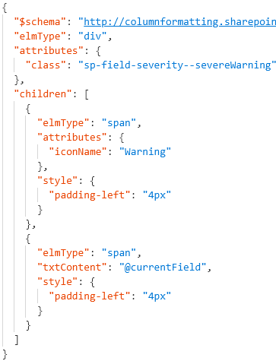
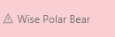
Format JSON
Rendered Column
Element Visualization
div
span
span
Generated HTML
<div class="sp-field-customFormatter sp-field-severity--severeWarning">
<span style="padding-left:4px;" iconname="Warning" class=" css-148"></span>
<span style="padding-left:4px;">Wise Polar Bear</span>
</div>

Slide 18

Expressions
Abstract Syntax Tree (AST)
operator/operands
Nest additional expressions
Excel-style expressions
Single line
Combine expressions
Online Only

Slide 19

Arithmetic Operators
*Online Only
Operator | Does | Examples | Results
+ | Adds stuff (numbers & text) | “=4 + 5” “=@currentWeb+‘/lists‘” | 9 https://t.sharepoint.com/sites/s/lists
- | Subtracts stuff | “=97 - 10” | 87
/ | Divides stuff | “=25 / 5” | 5
* | Multiplies stuff | “=5 * 5” | 25
% | Modulus* (remainder) | “=@rowIndex % 2” | 1 or 0
cos | Cosine | “=cos(5) | 0.28366218546322625
sin | Sine | “=sin(90)” | 0.8939966636005579
abs | Absolute Value* | “=abs(-45)” | 45

Slide 20

Conditional & Logical Operators
Operator | Does | Examples | Results
? or if | if(condition, when true, when false)
< | Less than | “=if(1 < 2, ’cat’, ’dog’)” | cat
> | Greater than | “=if(1 > 2, ’cat’, ’dog’)” | dog
<= | Less than or Equal | “=if(2 <= 2, ’horse’, ’duck’)” | horse
>= | Greater than or Equal | “=if(2 >= 3, ’horse’, ’duck’)” | duck
== | Equals | “=if(5 == 5, ’badger’, ’hen’)” | Badger
!= | Not equals | “=if(7 != 7, ’badger’, ’hen)” | hen
|| | Or | “=if(1<2 || 1<0, ‘man’, ‘elf’)” | man
&& | And | “=if(1<2 && 1<0, ‘man’, ‘elf’)” | elf
This Photo by Unknown Author is licensed under CC BY-SA-NC

Slide 21

Conversion Operators
*Online Only
Operator | Does | Examples | Results
toString | To text | “=toString(45)” | “45”
Number | To a number | “=Number(‘365’)” “=Number(‘Wowee’)” “=Number(Date(‘12/26/1981’))” | 365 NaN 378190800000
Date | To datetime | “=Date(‘12/26/1981’)” “=Date(378190800000)” | 12/26/1981 12:00:00 AM 12/26/1981 12:00:00 AM
toLowerCase* | Text to lowercase | “=toLowerCase(‘DogFood’)” | dogfood
toLocaleString | Datetime to locale text | “=toLocaleString(@now)” | “5/21/2019, 2:25:12 PM”
toLocaleDateString | Datetime to locale date only text | “=toLocaleDateString(@now)” | “5/21/2019”
toLocaleDateTimeString | Datetime to locale time only text | “=toLocaleDateTimeString(@now)” | “2:25:12 PM”

Slide 22

Mulit-Value & Loop Operators
Online Only
Operator | Does | Examples | Results
indexOf | Character index (starting at 0) of some text within text | “=indexOf(‘DogFood’, ‘Dog’)” “=indexOf(‘DogFood’, ‘F’)” “=indexOf(‘DogFood’, ‘Cat’)” “=indexOf(‘DogFood’, ‘f’)” | 0 3 -1 -1
length | Number of multi-value values | “=length([$MultiChoice])” “=length(‘Some Text’)” “=length(‘’)” | 3 1 0
join | Turns multi-values into text with a separator | =“join([$MultiChoice], ‘, ‘)” =“join([$MultiChoice], ‘|‘)” | “A, B, C” “A|B|C”
loopIndex | Current index of an iterator (forEach) | “=loopIndex(‘personIterator’)” | 2

Slide 23



forEach
“VirtualFieldName in ArrayField”
@currentField
or
[$SomeOtherField]
Cannot add to Root Element
Turns element into a template
Repeated for each item in the array
Creates Virtual Field
Access using Field Syntax [$personIterator]
Name appropriately (don’t clobber your fields)
Can be nested

Slide 24

loopIndex
Zero-Based
Position in forEach loop
Meaningless outside of loop
Specify the iterator name
“=loopIndex(‘personIterator’)”
Rhymes with PoopWindex

Slide 25
Flow Run Tracking
Set Flow Instance URL in Power Automate
concat('https://flow.microsoft.com/manage/environments/', workflow()?['tags']['environmentName'],'/flows/',workflow()?['name'],'/runs/',workflow()?['run']['name’])
Store with the list item (or in a separate list)
Use Formatting to create a link
Notes:
https://github.com/pnp/List-Formatting/tree/master/column-samples/generic-flow-status

Slide 26

List Formatting Limitations
Date Parts operators, but no Time Parts
Unable to use parenthesis in style props (except for rgba)
No Gradients
No image backgrounds
Schema discrepancies
No localization
Teams Inconsistencies
Form Formatting doesn’t use Monaco Editor
Form Formatting doesn’t follow the same rules
Body Layout has no real formatting options

Slide 27

List Formatting Awesomeness
Quick & “easy” visualizations that can have a significant impact
Site Column integration
Can be applied by Site Designers
Supported in Site Templates & Remote Provisioning
Great performance
Getting better all the time
NO Solution Package deployment required

Slide 28

Final Tips & Tricks
Start with the Samples
Customize the Wizard output
Turn debugMode off when not editing
Write HTML 1st
1800+ icons – use them!
Test in multiple themes
Attend the PnP Calls

Slide 29



PnP SIG SharePoint General Development Call
Previous List Formatting Tips covered
currentWeb
forEach, loopIndex
Contains, StartsWith, indexOf
Design Mode
Alternating Row Styles
Conditionally launching flows
Multi-line field formats
ContentTypes
Custom Row Actions
UI Fabric Classes (themed formats)
Customizing the Flow Panel
SVG Icons
Every other Thursday, 10am EST
Recorded to YouTube
Next call on Dec. 8th
Recurring List Formatting tips & tricks
Notes:
https://aka.ms/spdev-sig-call

Slide 30
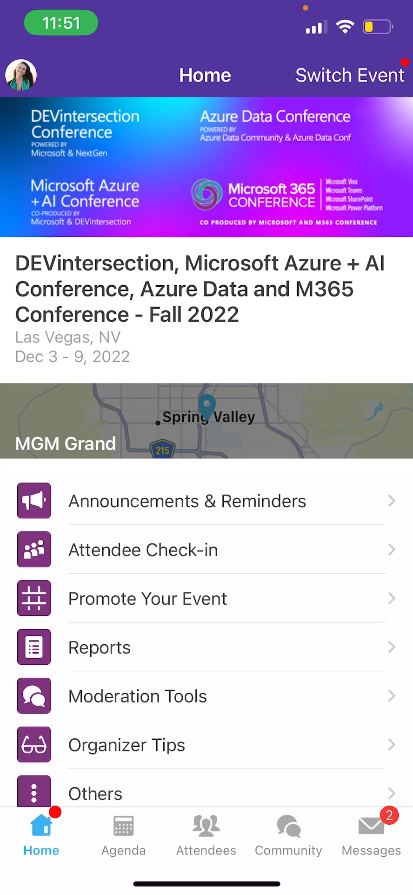
Session Feedback Surveys
In the pursuit of making our conferences even better, we need to hear your feedback about this session.
Here’s How -
Simply go to the Whova App on your smartphone
Go to the conference homepage
Scroll down to ‘Additional Resources’ and click ‘Surveys’.
Click ‘Session Feedback’.
Scroll down to click on this session title.
Complete the session feedback survey.
Finally, click ‘Submit’

Slide 31


Slide 32


@theChrisKent
theChrisKent.com
aka.ms/list-formatting
bit.ly/lf-videos
aka.ms/m365pnp
aka.ms/offdp

